Slide 1


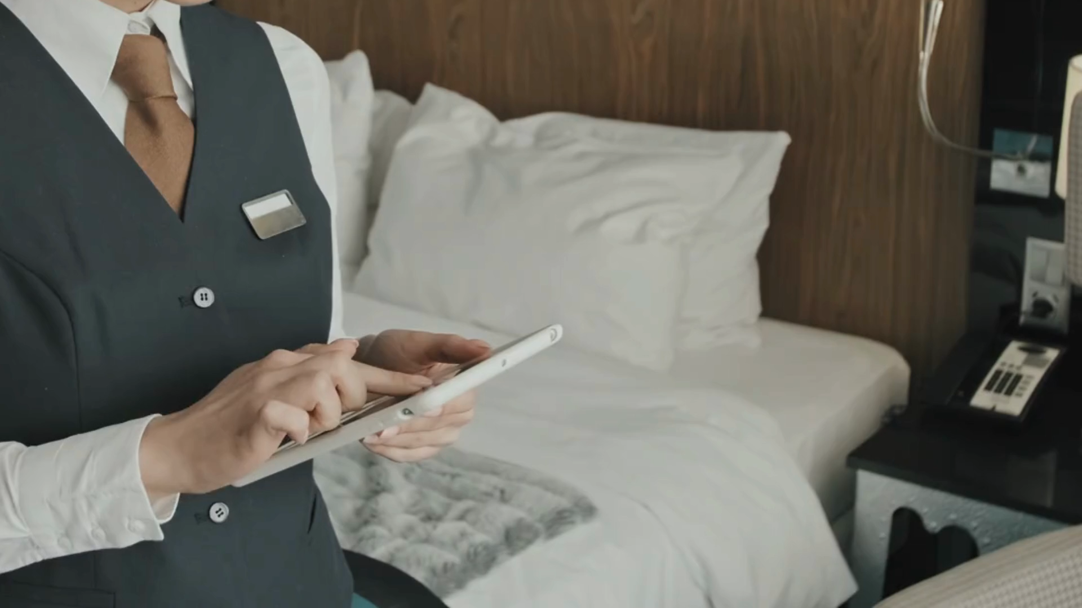

Digital Hotel
The Future of Hotels

Slide 2

Why?

Slide 3


Supports the digitization of more than 95 hotel services
Increases the rate of returning customers by 35%
Offers more than 130 languages
Increases the rate of service requests by 40%
Reduces employment cost by 25%
Improves the quality of work by 70%
Contributes in achieving more revenues by 20%
Increase the number of visits to social media platforms by 25%
Contributes in the advancement of the system services within 80%

Slide 4

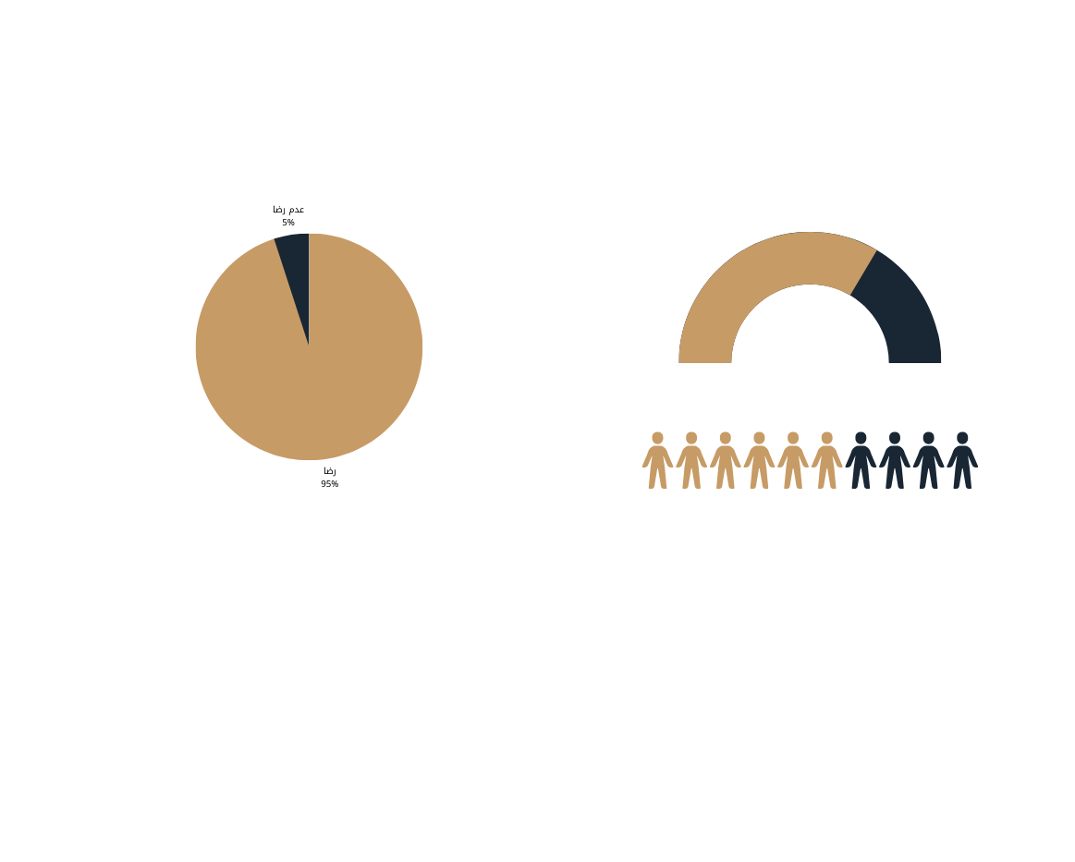
Yearly indicators
More than 95% user- satisfaction rate
More than 1 million and 500k visitor

Slide 5



Satisfied civilians and visitors: achieves immense local satisfaction and an excellent quality of life following the footsteps of the governmental digital services
Green governance: reduces carbon dioxide emissions in every step of the general digital services
This strategy builds creative digital models that will contribute to raising the demand for tourism services it also includes employing innovative regulations to manage smart hotels

Slide 6

How?

Slide 7




The digital transitioning in
hotel services program

Slide 8
content
Concept& Goals
Digital Hotel Components
Digital Hotel Features
Digital Hotel System Operating
Digital Hotel Life Map
01
02
03
04
05

Slide 9

Digital governance strategy
For the period 2023 to 2030
Satisfied civilians, locals and visitors: achieves an immense local satisfaction and an excellent quality of life following the steps of the governmental digital services
competitive businesses: business performance enhancement primarily through the employment of a digital system
Digital transition: achieving governance transition through integrating technologies in operation and decision-making
Green governance: reduces carbon dioxide emissions in every step of the general digital services

Slide 10
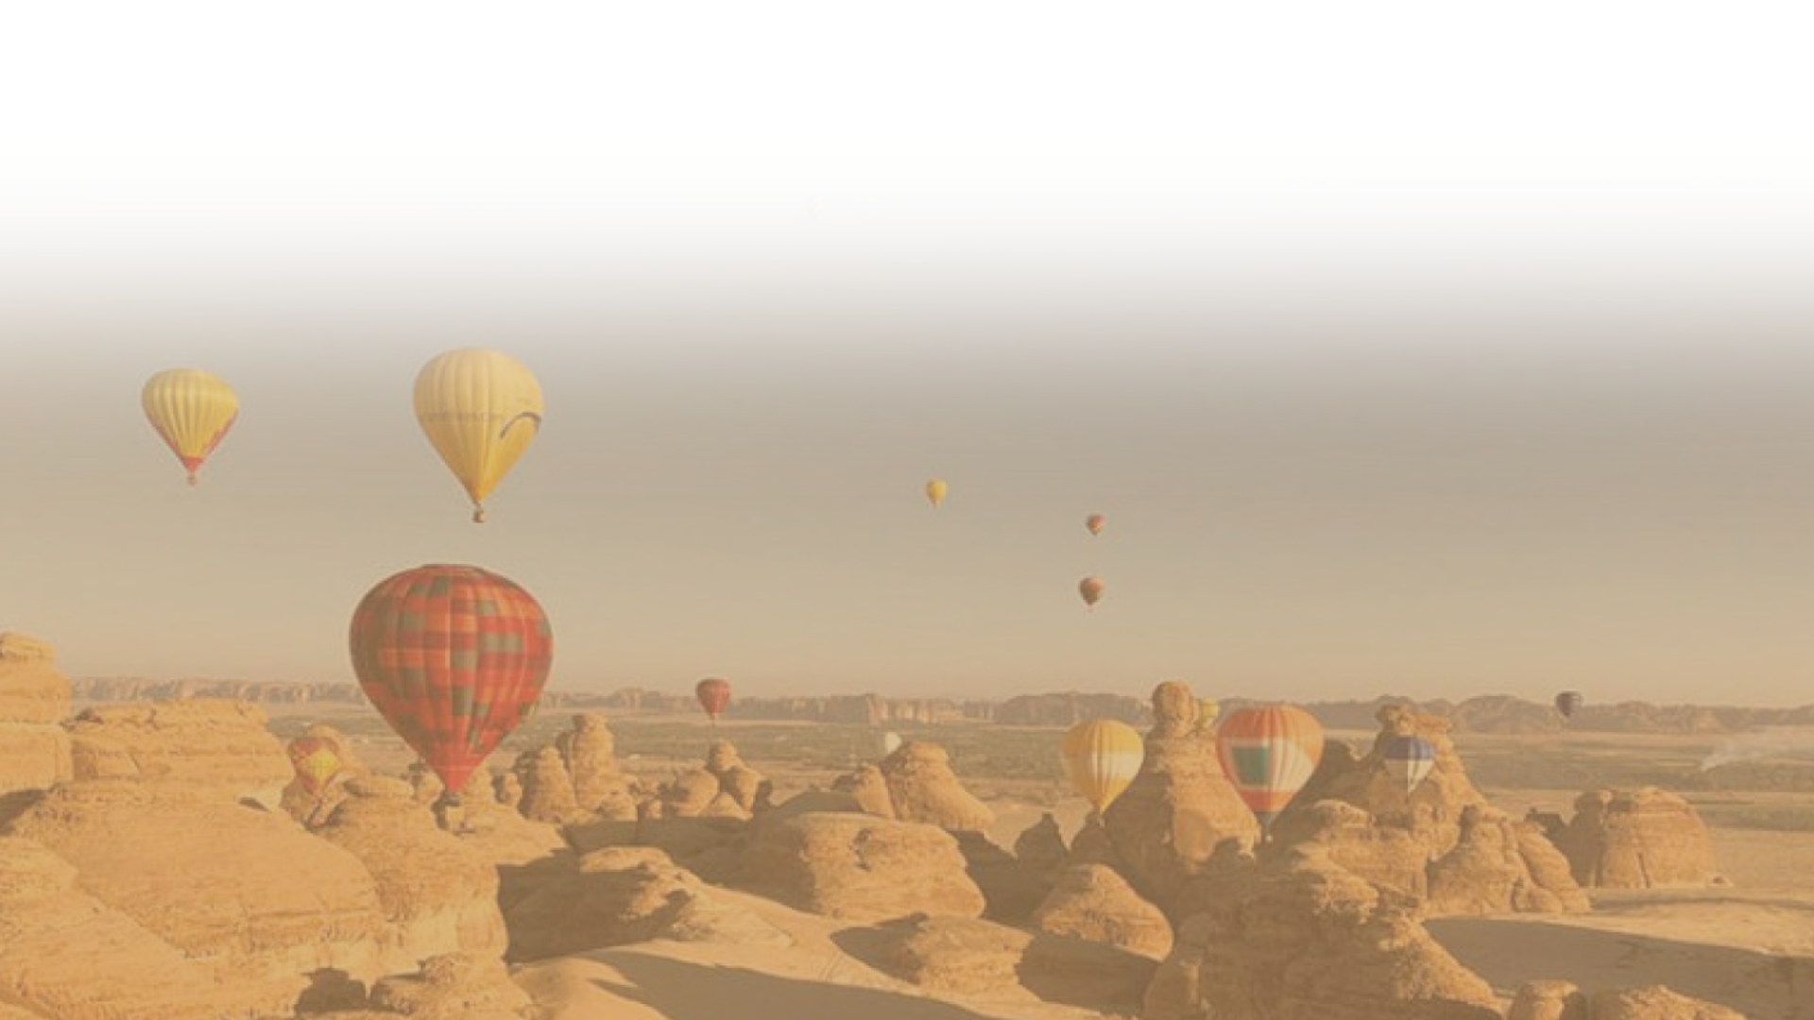
Digital tourism strategy in Saudi Arabia
This strategy works to build innovative digital models that will contribute to raising the demand for tourism services, it includes employing innovative regulations to manage smart hotels, as well as adopting flexible methods for digital traveling procedures, and providing smooth travel experience for tourists, business men and government employees, it also includes inducing the provision of new services.

Slide 11


Concept& Goals
01

Slide 12

Digital Hotel Concept
In response to rapid digital transformation, Digital Hotel was created. It features a smart QR code that is assigned to each hotel room. This code can be easily translated into over 130 languages, greatly enhancing the guest experience. By scanning the QR code, guests can access information about the hotel, its services, facilities, and other details that can be easily updated. Guests can also use the QR code to select services and complete procedures electronically, eliminating the need for contacting room service and saving time and effort.
SCAN

Slide 13

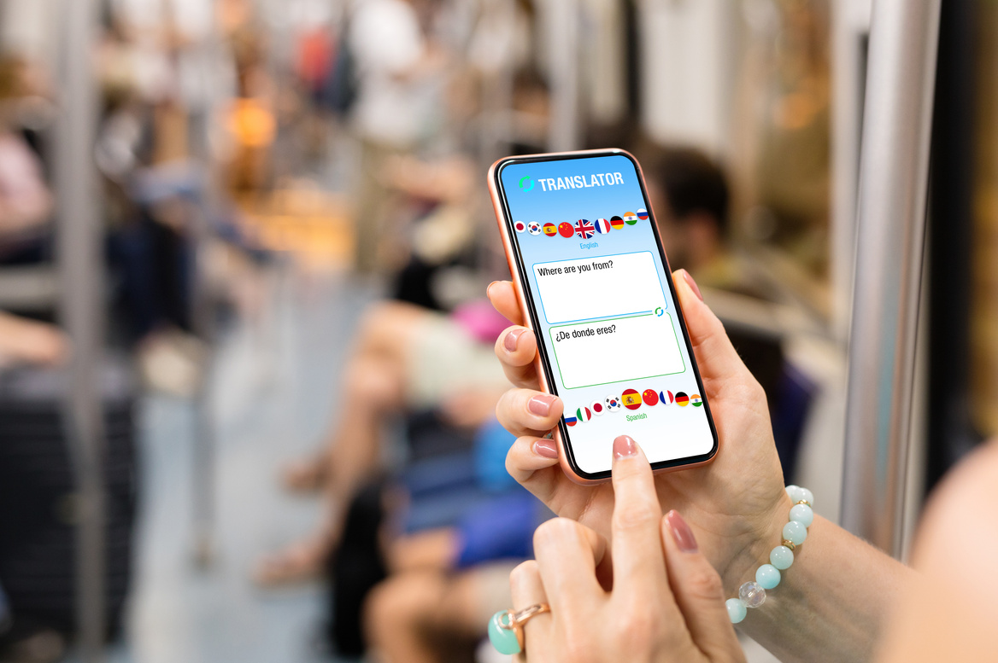


Digital Hotel Goals
1
2
3
4
Reduce call waiting times and improve the efficiency of the registration process
Hotel guests of any nationality can easily order in their preferred language
Ensure that guests experience the highest standards of quality and well-being during their stay
Simplify room service with electronic display and ordering

Slide 14

Digital Hotel Components
02

Slide 15
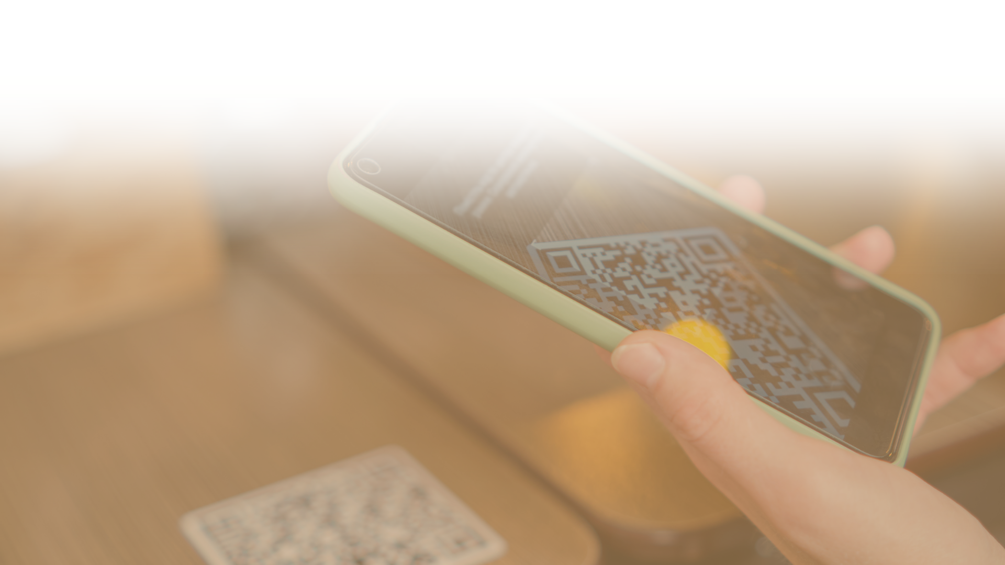
At Digital Hotel, we strive to provide customers with a fully electronic experience, building trust and loyalty while reducing costs and increasing revenue.
Advertising banner
Hotel brief introduction
Hotel Services
Communications channels
Customer Satisfaction Survey

Slide 16
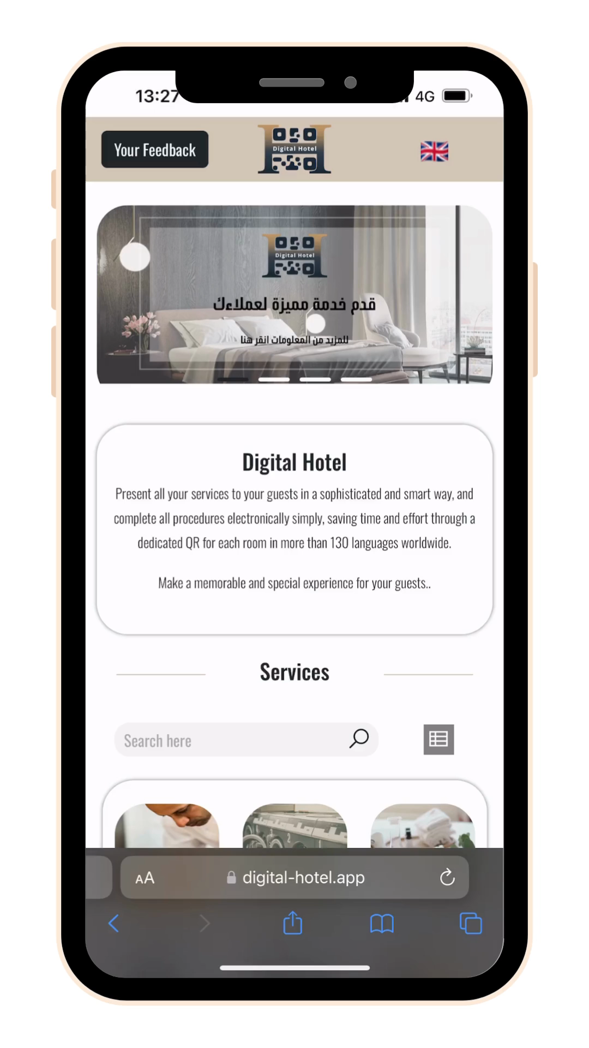

First: Advertising Banner
The banner space is a great way to grab guests' attention and display an unlimited number of ads. It's perfect for promoting hotel services or external services (paid advertising marketing). It can also be used to inform guests about the latest offers and discounts, among other things.

Slide 17
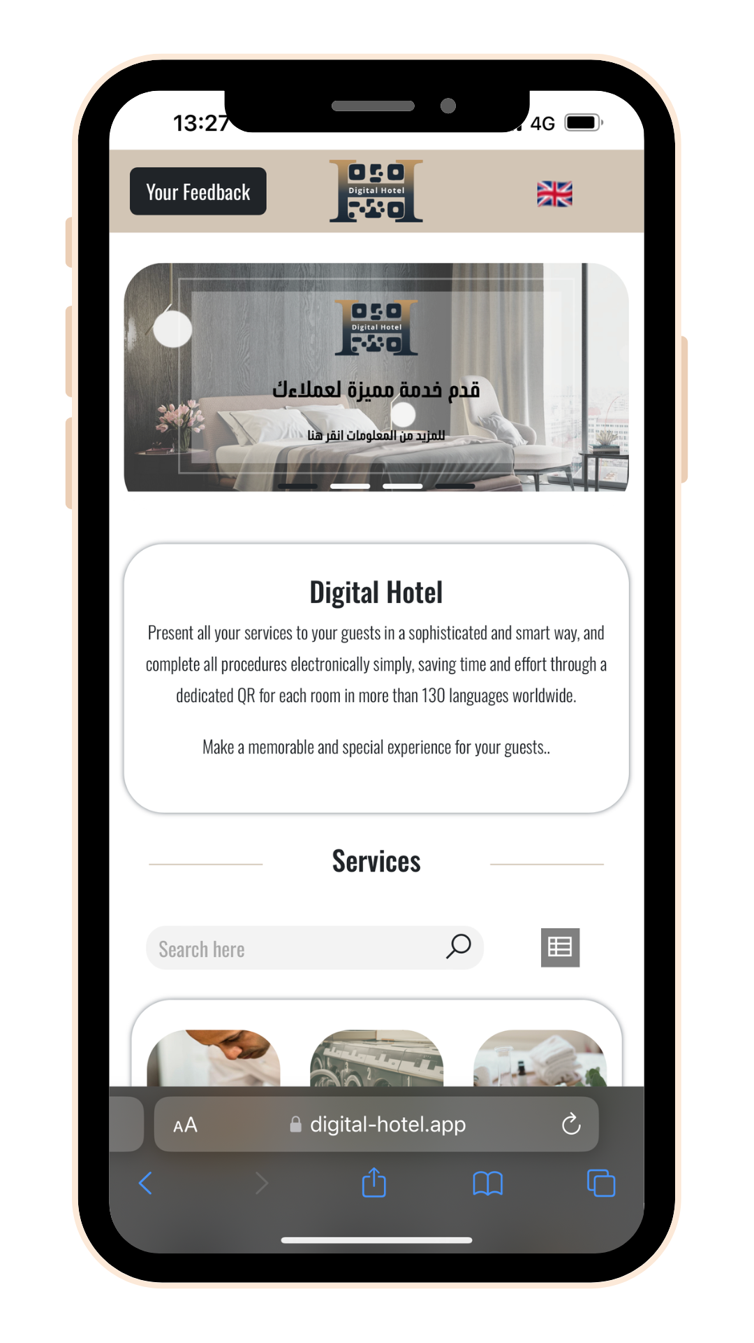
Second: Hotel Brief Introduction
The "About Us" section of a business profile is crucially important. It functions like a CV for a hotel, allowing guests to learn more about the establishment and feel confident in their choice. A well-crafted "About Us" section can help turn casual visitors into potential customers and leave a positive impression on them.

Slide 18
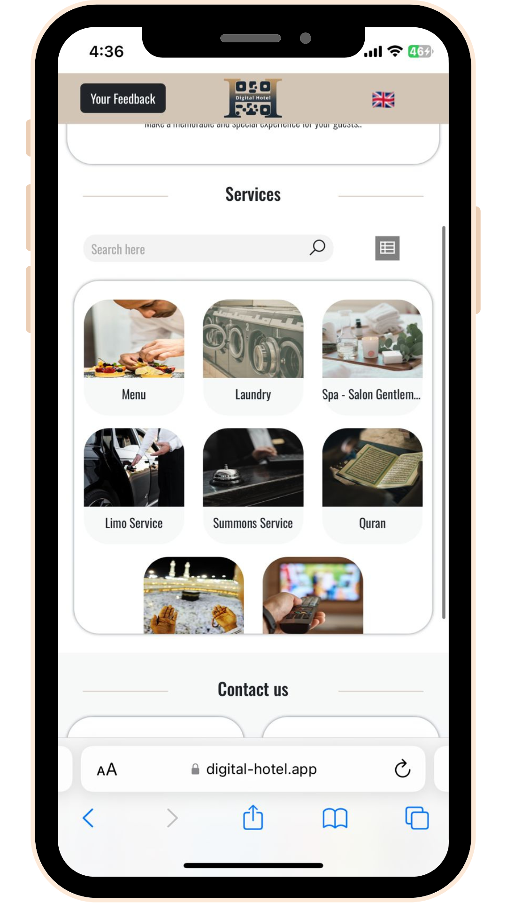
Third: Hotel Services
Display all the hotel services and make the services easily accessible through an attractive digital platform for a delightful customer experience.

Slide 19
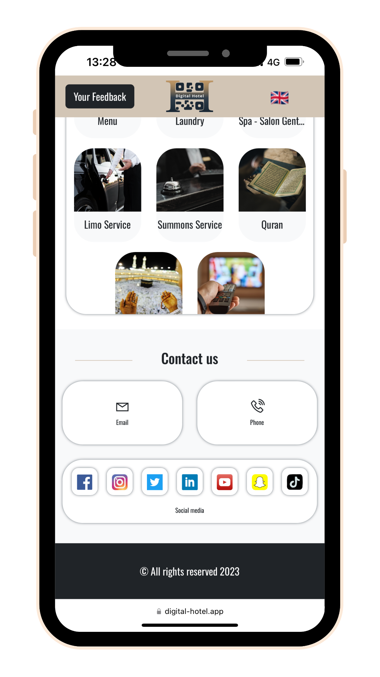
Fourth: Communications Channels
Add your contact information, social media accounts, email, and contact numbers

Slide 20
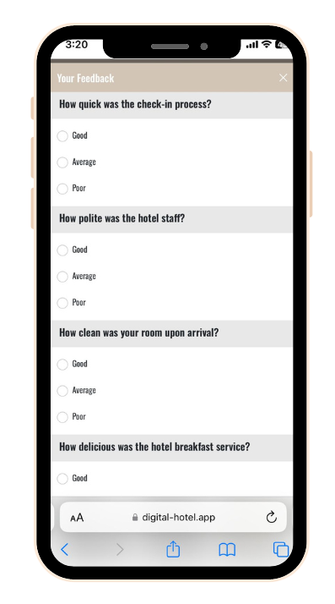
Finally: Customer Satisfaction Survey
Gaining the trust and loyalty of guests is crucial for any business, as a satisfied customer is more likely to recommend your services to others. The electronic questionnaire service helps you stay informed about your customers' needs and desires, allowing you to meet their expectations and achieve satisfaction. This helps to establish long-lasting relationships with your customers.

Slide 21
Digital Hotel Features
03

Slide 22

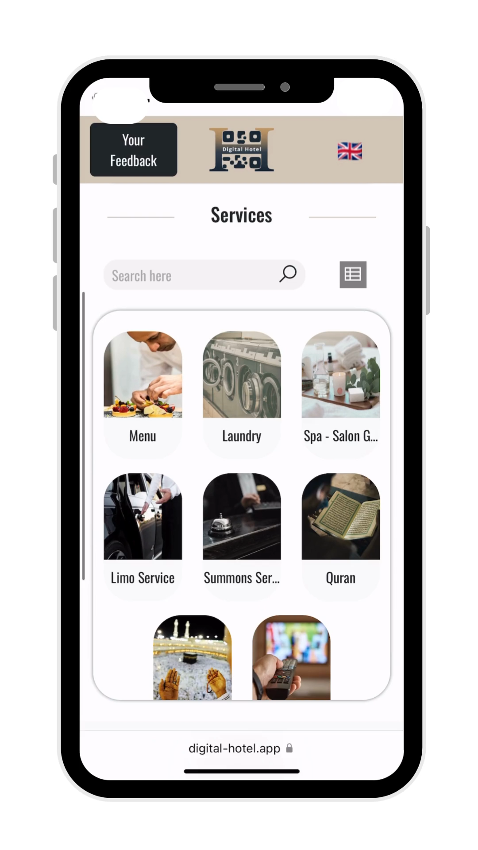

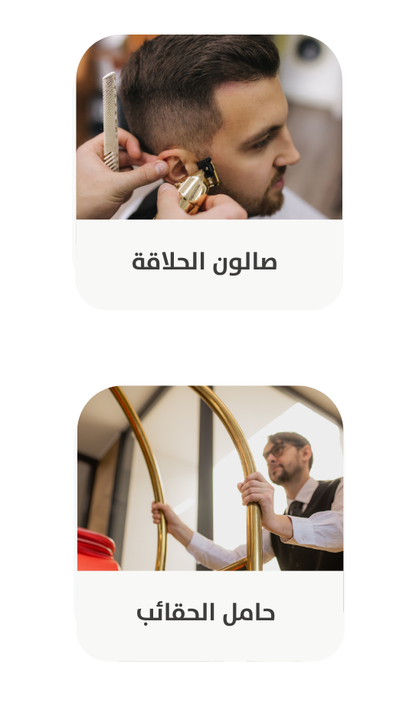
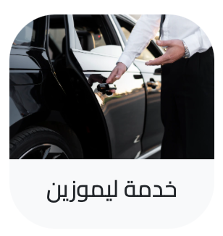

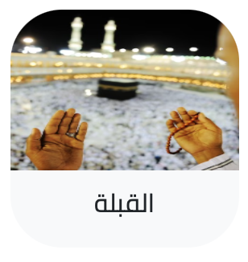
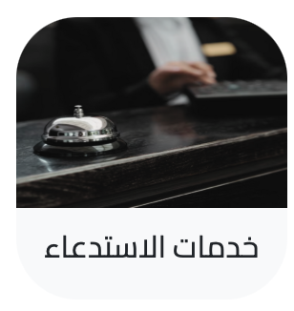

95
Supports digitizing over
different hotel services
TV channels
Limo service
Barber shop
Spa – men salon
Qiblah
Bellboy
Quran
Summoning service

Slide 23
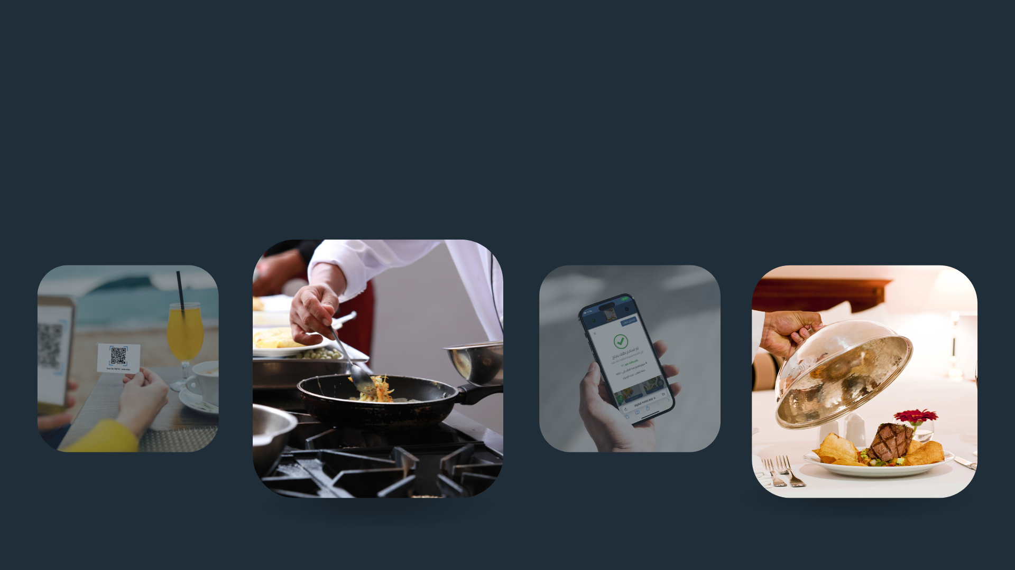
Complete work system technology starting from displaying of services, ordering and tracking the orders up until delivery
01

Slide 24
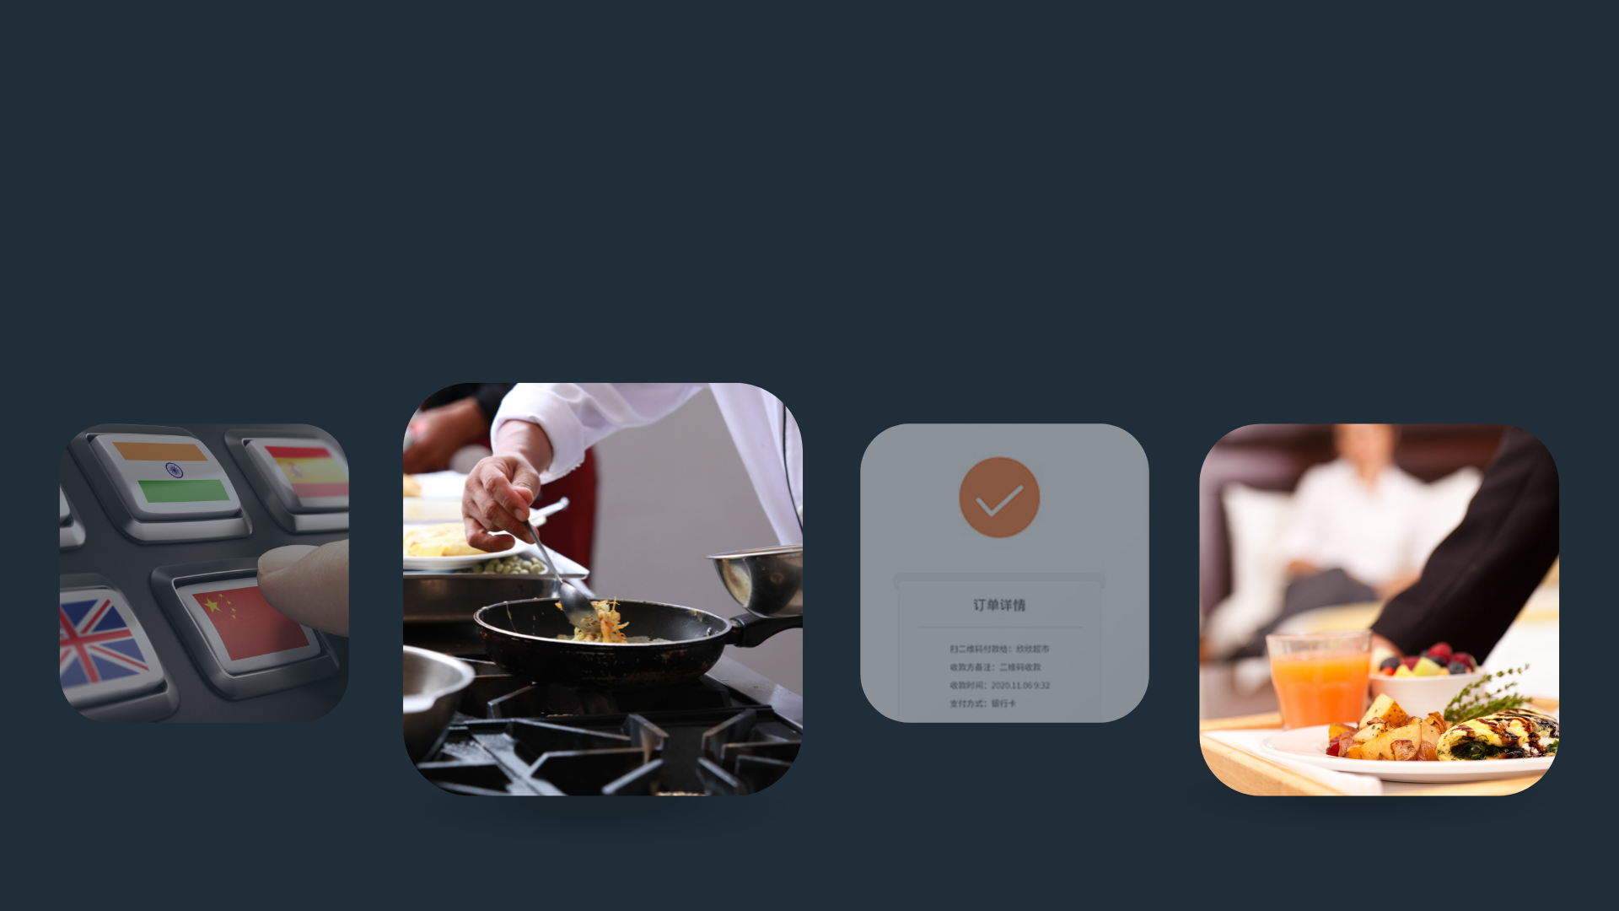
The system is translated into more than 130 languages around the world so that every customer can easily browse services, order, and track orders in their language
02

Slide 25





Digital Hotel technology contributes to reducing operational costs as well as achieving work quality.
03
Cancellation of paper transactions
Reduces human intervention
Being up to date with technology
Increases profit sales

Slide 26




Digital Hotel has been programmed according to the latest technology to become compatible with different screen sizes and help achieve a wonderful user experience for users from different nationalities of the world.
04

Slide 27
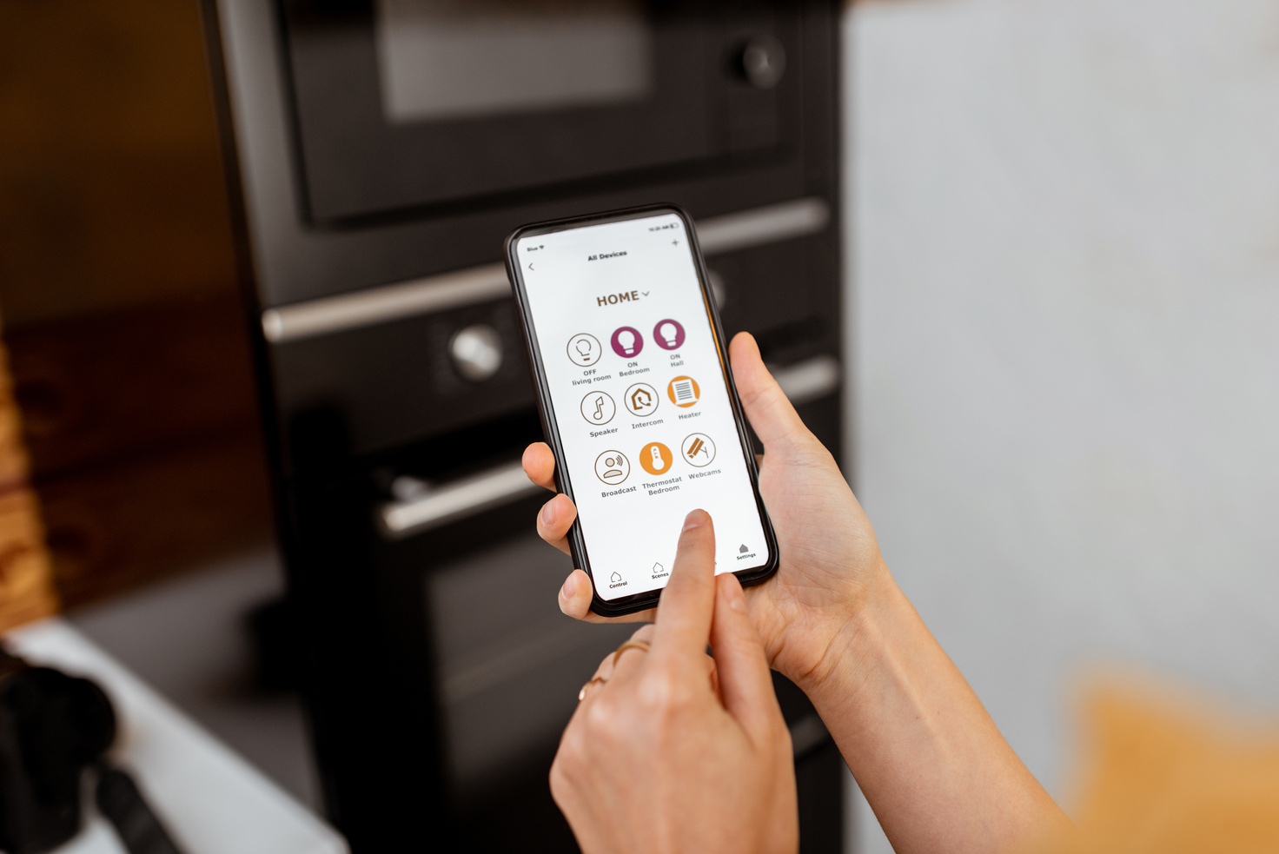
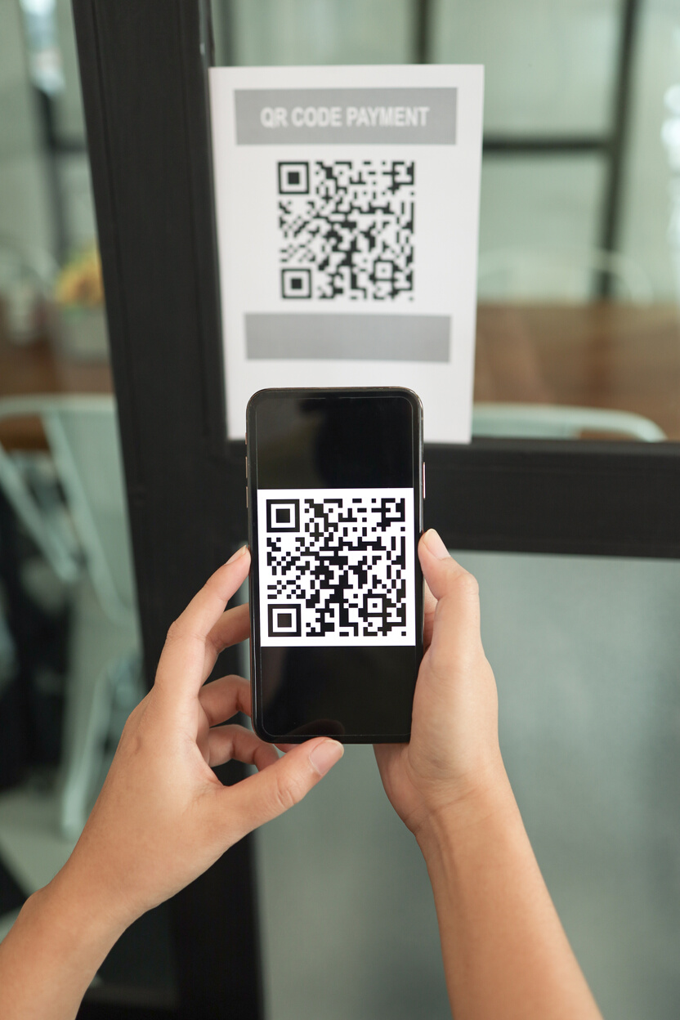


Ease and speed in receiving and fulfilling orders using quick and safe technical steps
05

Slide 28
Digital Hotel System Operating
04

Slide 29



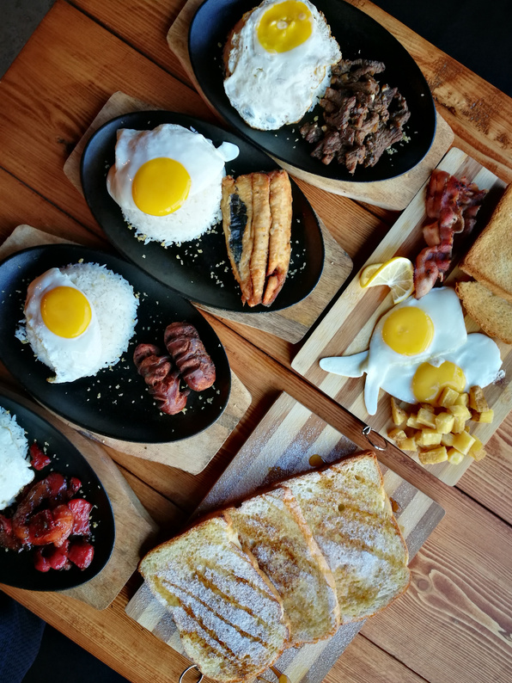

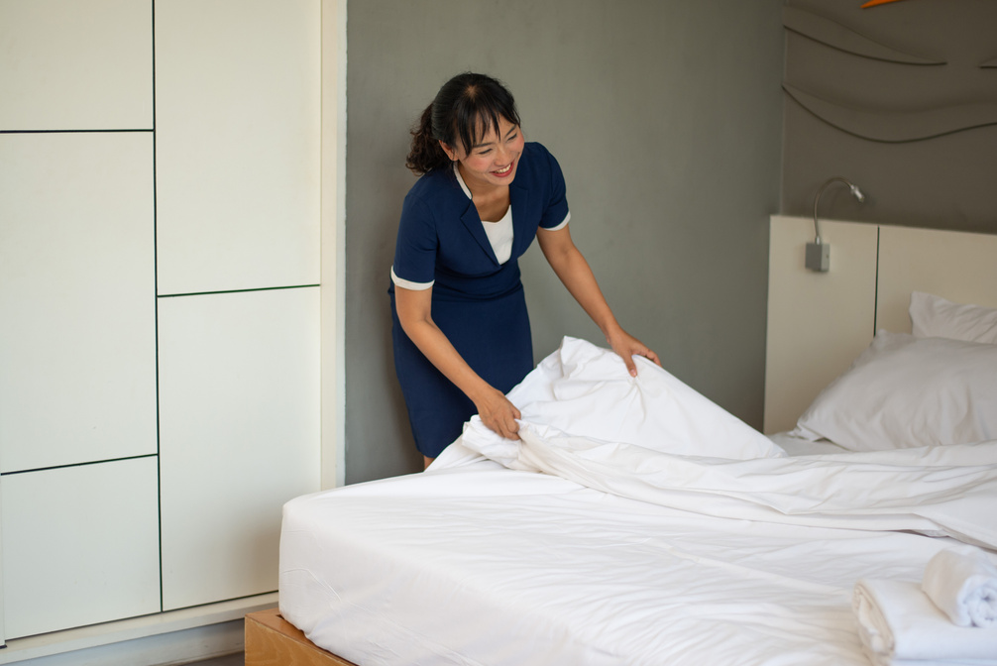
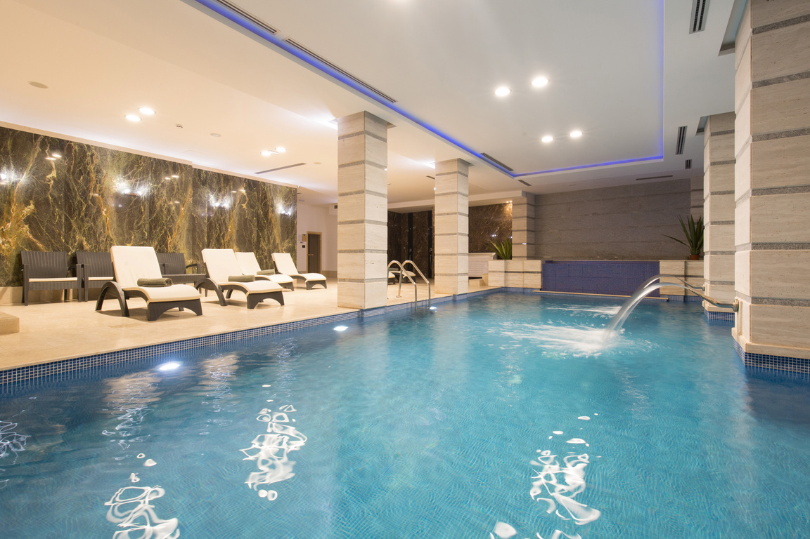
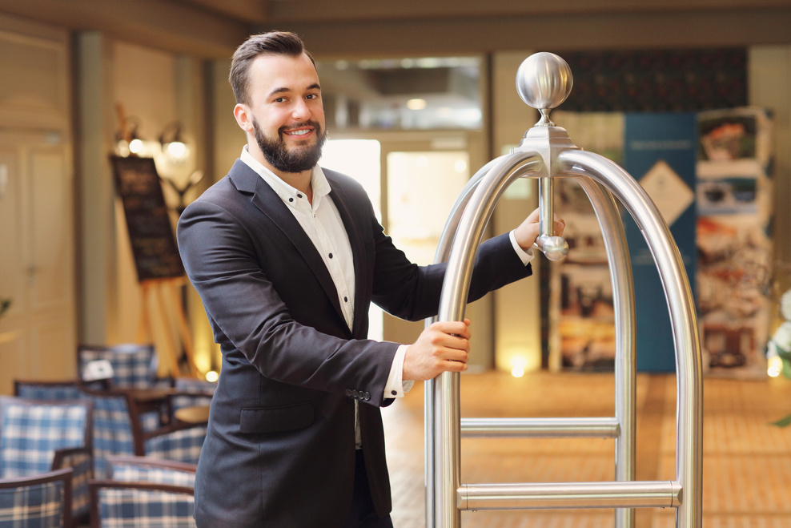

01
Hotel details and services are all added at once in the dashboard

Slide 30
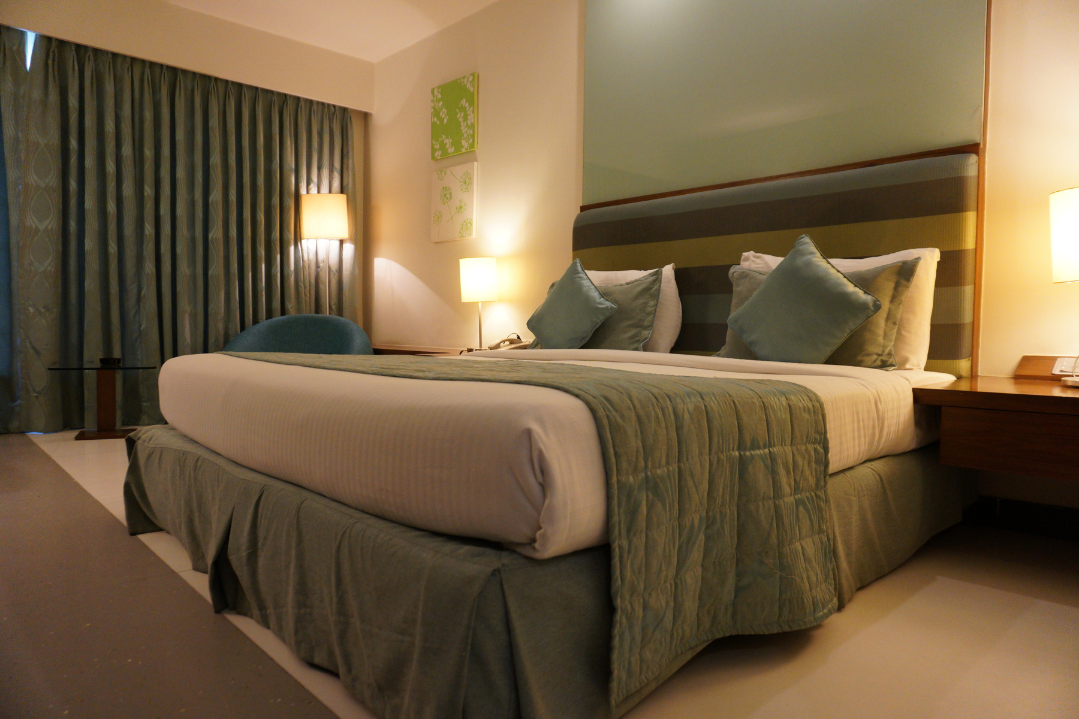
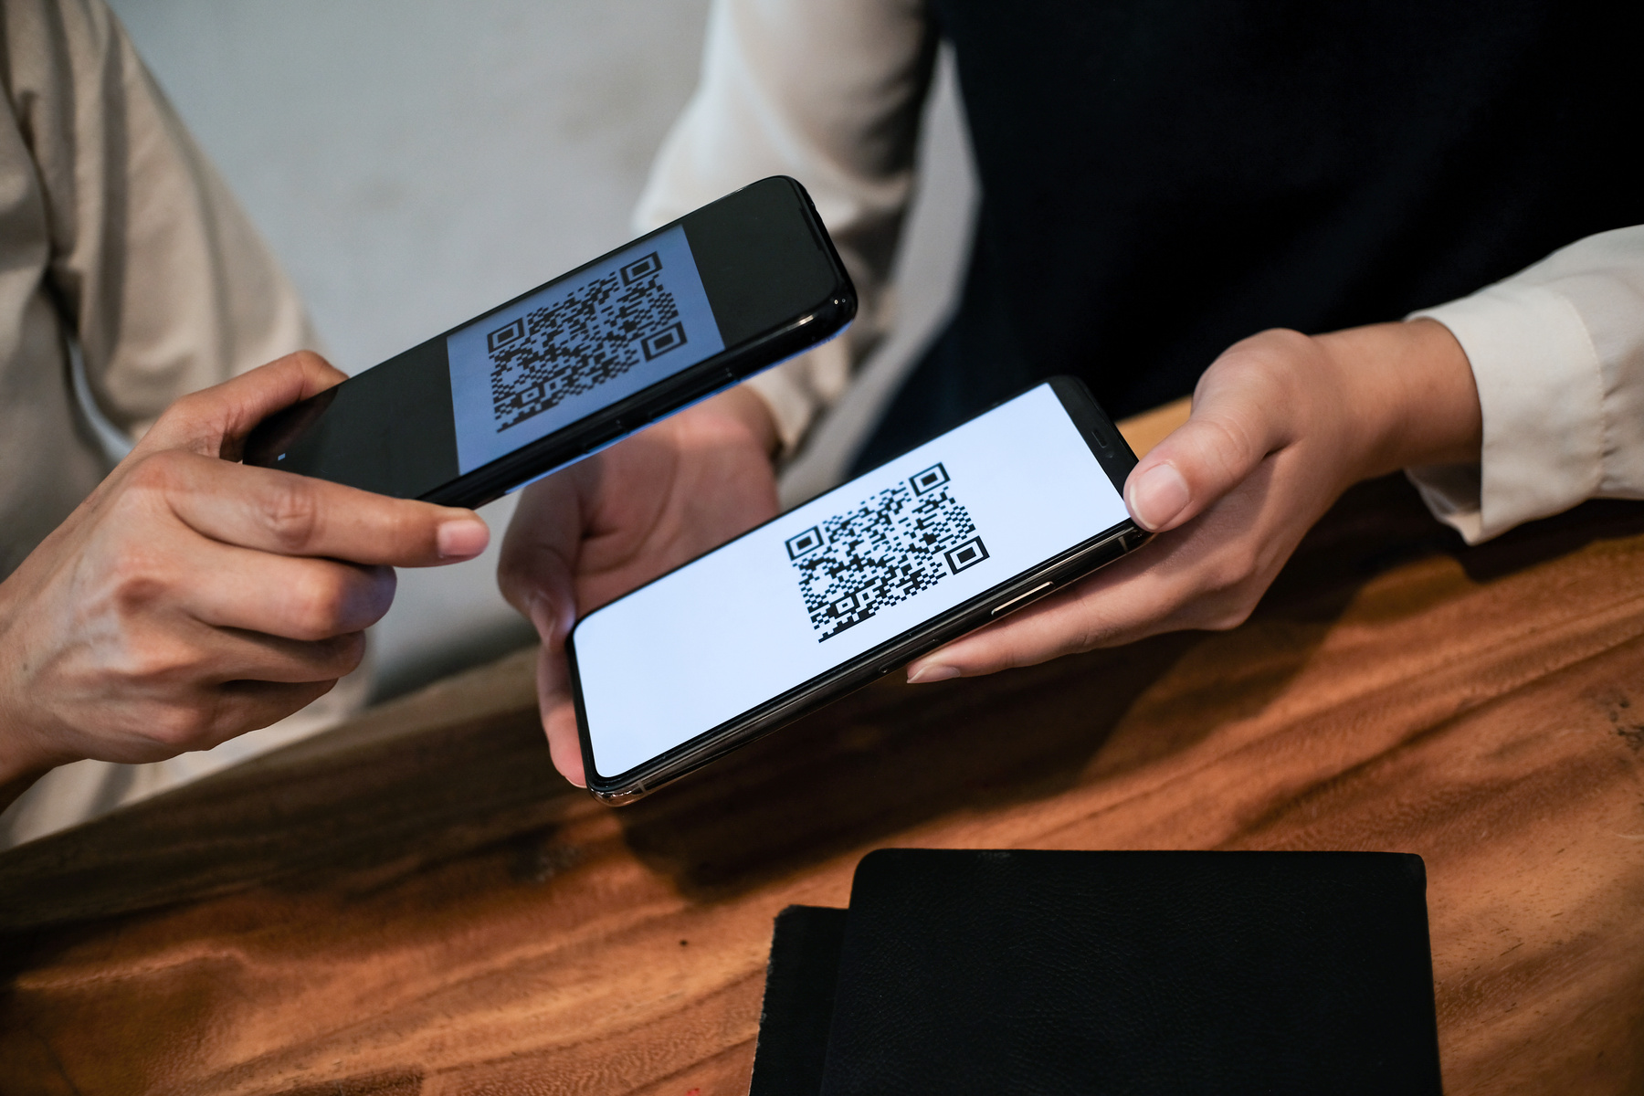
02
A quick response (QR) code is then generated for every room in the hotel

Slide 31
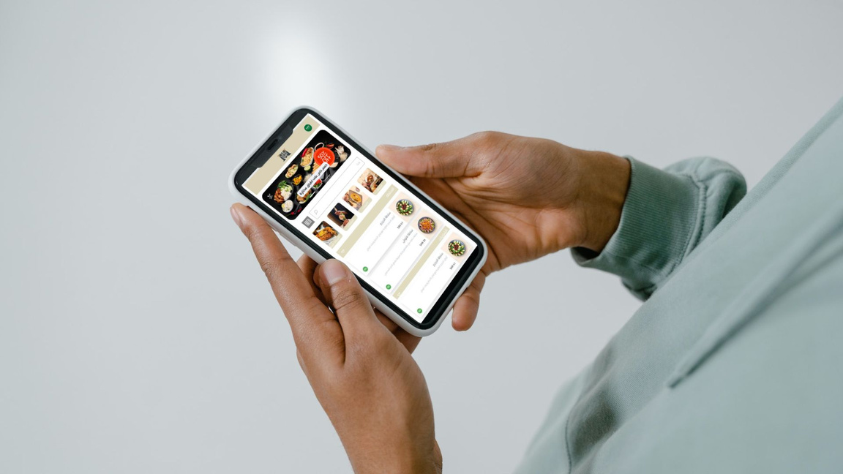

Hotel guests can then scans the QR code, choose their suitable language, browse details and services and start ordering with ease
03

Slide 32
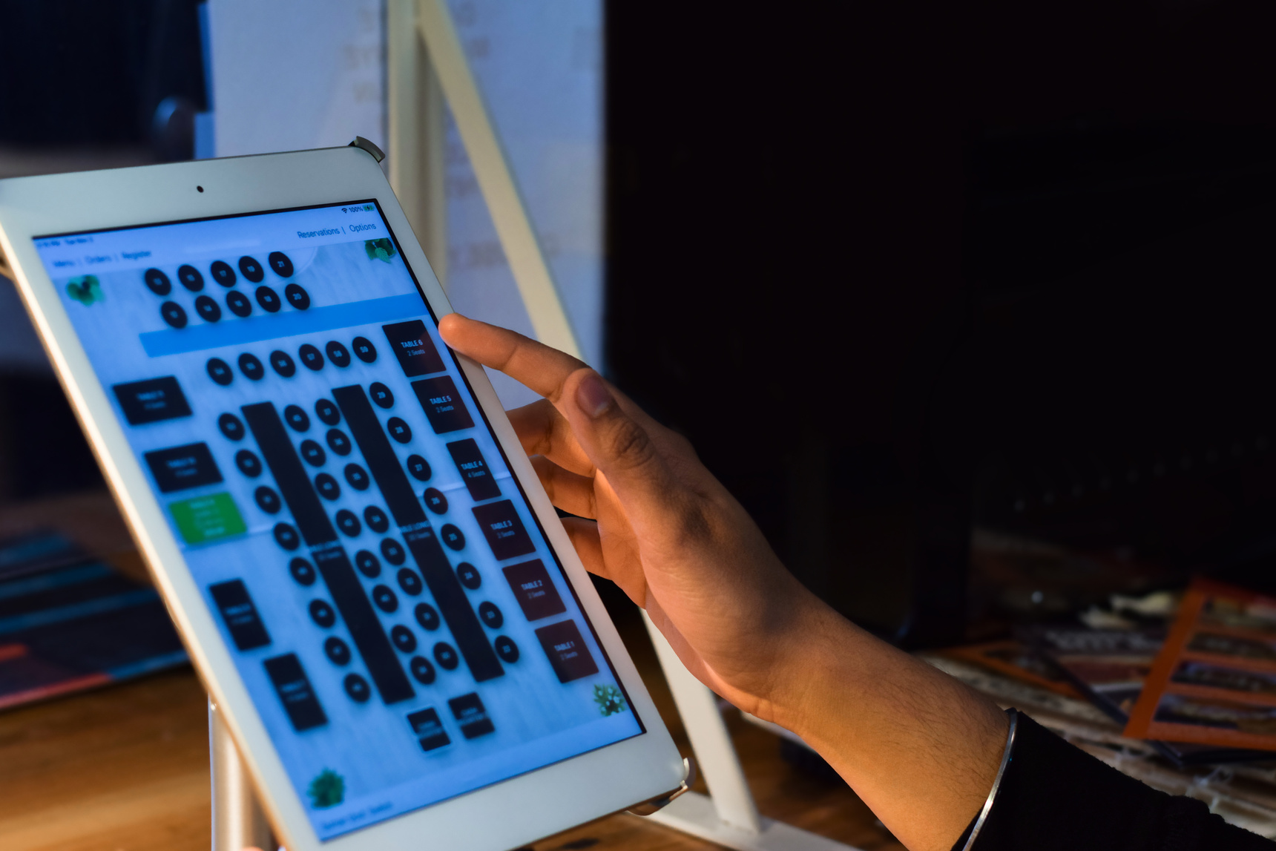
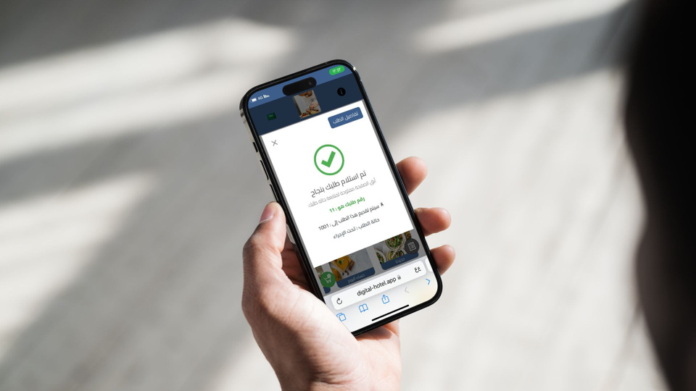
After completing the order, an icon appears to the guest confirming the order has been received, and through this icon the guest can also track the order directly
04

Slide 33
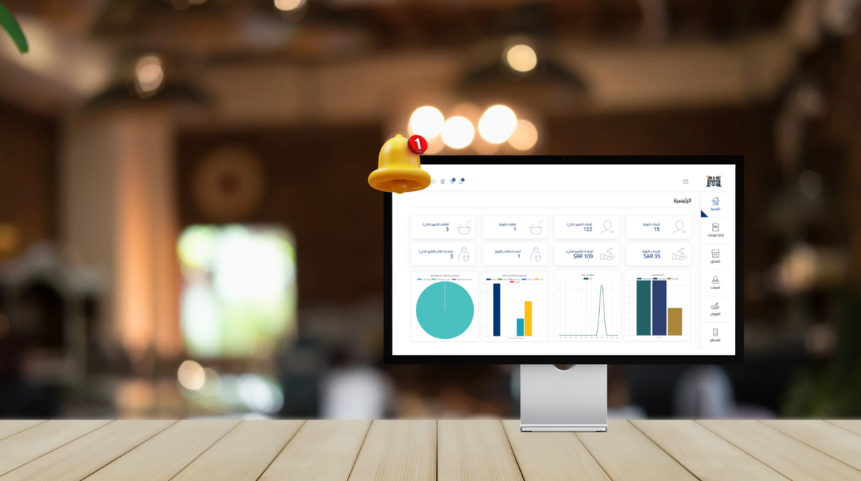

The order then shows on the dashboard given to the hotel restaurant, and the person in charge reviews the order and room number and completes the next steps of preparing and delivering the order.
05

Slide 34

When?

Slide 35

Digital Hotel Life Map
05

Slide 36
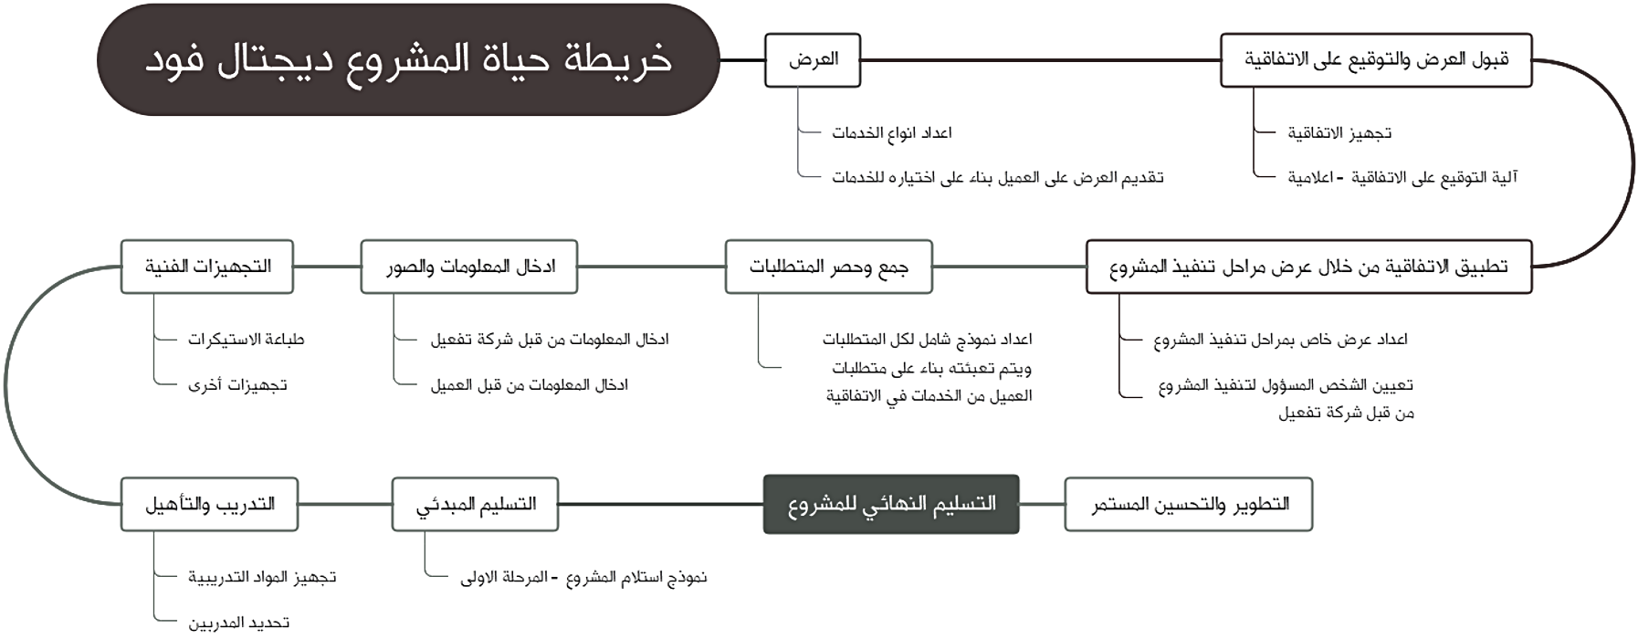



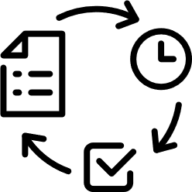






Digital hotel life map
offer
Accepting the offer and
signing the contract
Number of kinds of services
contract preparation
Presenting an offer to the client based on the chosen services
contract signing mechanism – informative
Technical preparations
information and images entry
Collecting and listing of the requirements
Contract is then applied through the presentation of implementation stages of the project
Stickers printing
Information and images entry done by activation company
Prepare a model that includes all requirements that are based on the services picked by the client in the contract
prepare a presentation of implementation stages of the project
Other preparations
Information and images entry done by the client
Appointing the person in charge of implementing the project by Activation Company
Training and qualifying
Initial submission
Project final submission
Continuous developing
and improving
Preparing training materials
Project submission model – level one
Selecting trainers

Slide 37

Our sponsors

Slide 38





Our clients

Slide 39

Thank You

